Slide 1
Project Design Soldering Station
1
Sem Kirkels
1 EAI
Notes:
A soldering station is a handy tool. Unlike a conventional soldering iron or a gas operated soldering iron. The temperature of a soldering station can be regulated. A soldering station is also an important tool for future projects. This makes a soldering station a great project for “Project Design”.

Slide 2
Table of content
2
Introduction
Results
PCB design
Mechanical design
Issues
Notes:
Here is a quick preview of what will be discussed in this presentation. First the project is introduced. Than the results of the PCB design and mechanical design are illustrated. And finally I am going to reflect on the project.

Slide 3
Introduction
3
Temperature regulated
Powerful transformer
Heating large surfaces
3 soldering irons
Notes:
The temperature of the soldering station can be regulated. This makes it much more versatile compared to a regular soldering iron. Because the temperature can be regulated soldering smaller components are less likely to get burned.
The soldering station is equipped with a powerful transformer this makes it easy to solder large surfaces because the iron won’t lose as much heat.
The soldering station is unique to other soldering stations because it can use 3 different soldering irons.

Slide 4
Table of content
4
Introduction
Results
PCB design
Mechanical design
Issues
Notes:
Now that you know what the project is about let’s talk about the design and how it works.

Slide 5
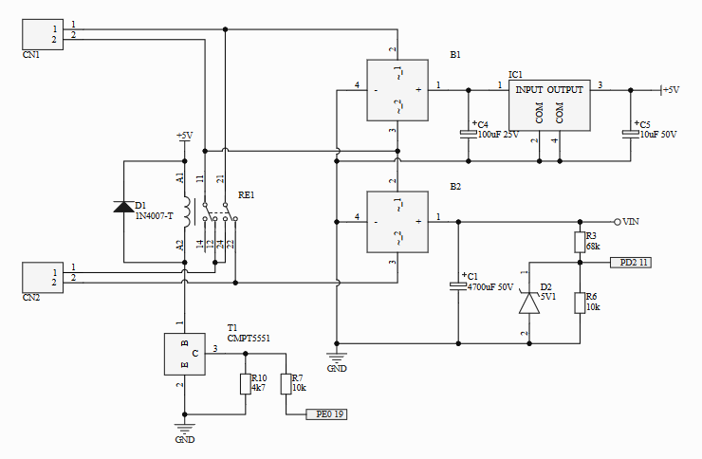
Results PCB Design
5
Altium Designer
Sub schematics
Power supply
Two input voltages
Notes:
For the electrical design Altium designer is used to create the schematics.
To ensure that the schematic is still clear it is split up into different schematics.
Here you see the first schematic. This is the power supply. It takes two 12V inputs. These get rectified. One part goes to the regulator and will be converted to a stable 5V DC voltage. The other end goes to VIN and can be 12V or 24V depending on the state of the relay.

Slide 6
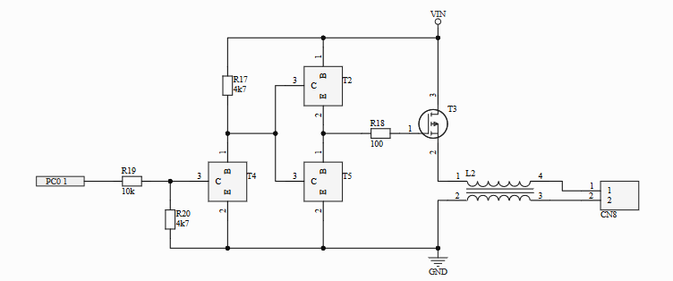
Results PCB Design
6
Controller circuit
ATmega
PWM
Notes:
This is the controller circuit. It controls the output power that generates the heat in the soldering iron. When transistor T4 gets a signal from the ATmega it switches and a path to ground is created. Transistor T2 stops conducting and T5 starts conducting. Since T3 is now connected to ground it starts conducting. This all stops when the ATmega does not send a signal.
The signal from the atmega is pulse width modulation. Because the atmega is not powerful enough to power the soldering iron it has to be amplified.

Slide 7
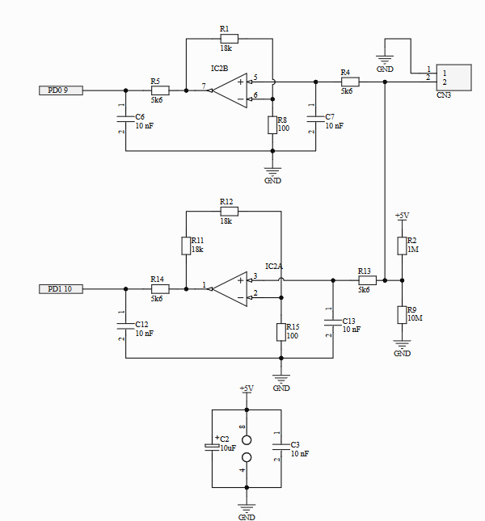
Results PCB Design
7
Amplifier circuit
Two thermocouples
Notes:
Here you see the amplifier circuit. This takes the output of the thermocouple and amplifies it so that the ATmega can read it. There are two amplifiers because not all the soldering irons have the same thermocouple.

Slide 8
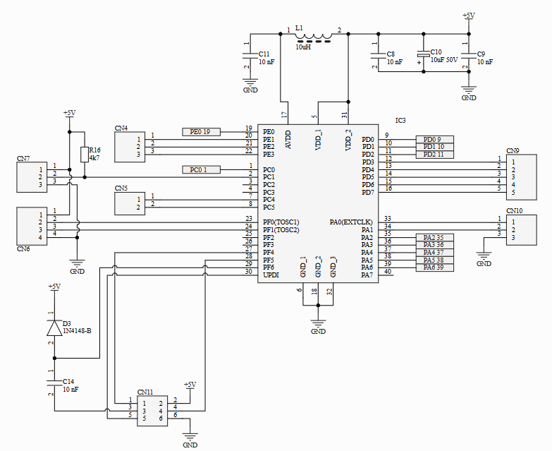
Results PCB Design
8
ATmega
Input voltage
Output voltage
Amplifier circuit
Display
Encoder
Notes:
This is the ATmega processor. This circuit controls the input voltage, output voltage and the amplifier circuit. It gives visual output via the display and takes user input with the rotary encoder.

Slide 9
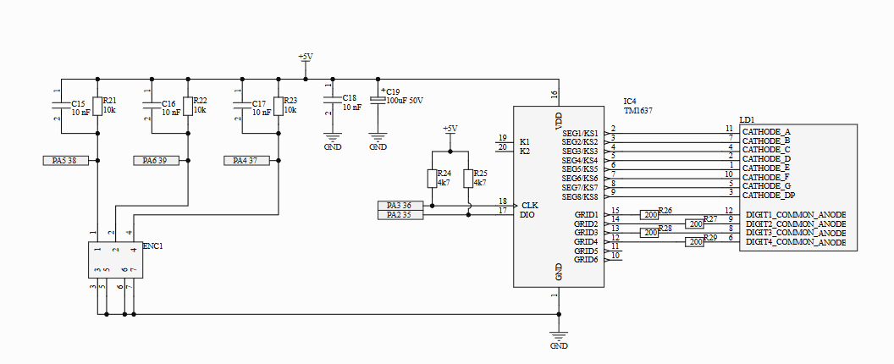
Results PCB Design
9
User input
Rotary encoder
Visual output
Display
Notes:
The last schematic is the display and encoder schematic. It receives user input from the rotary encoder and generates visual feedback with the display.

Slide 10
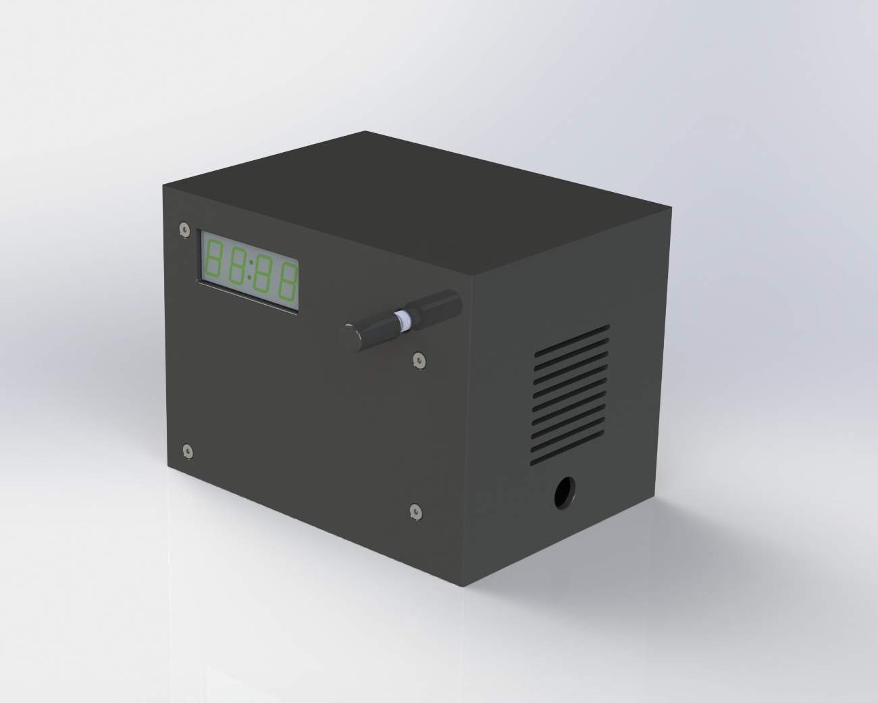
Results Mechanical design
10
Multiple parts
Each side is separate
Reduces printing time
Notes:
The other part of the project is the case design. SolidWorks CAD software is used to draw the case. The design is than 3d printed. The case is made out of multiple parts so that when a print does fail not the whole case has to be reprinted. This reduces printing time and material cost when a part fails.

Slide 11
Table of content
11
Introduction
Results
PCB design
Mechanical design
Issues
Notes:
For the final part the problems of the project are explained.

Slide 12
Issues
12
Symbols
THT transistors
MOSFET
Switching pins
7-Segment display
Notes:
There are a number of things that went wrong during this project. Using the wrong symbols in the schematic is the first problem. That there was some confusion with the MOSFET. The symbol is not drawn correctly but the pins are placed correctly. The last problem is still ongoing. The wrong 7-segment display was send by the manufacturer. This will be solved once the replacement has arrived.

Slide 13
Project Design Soldering Station
13
Notes:
Now that you have a better view of the project, are there any questions?

